Slide 1
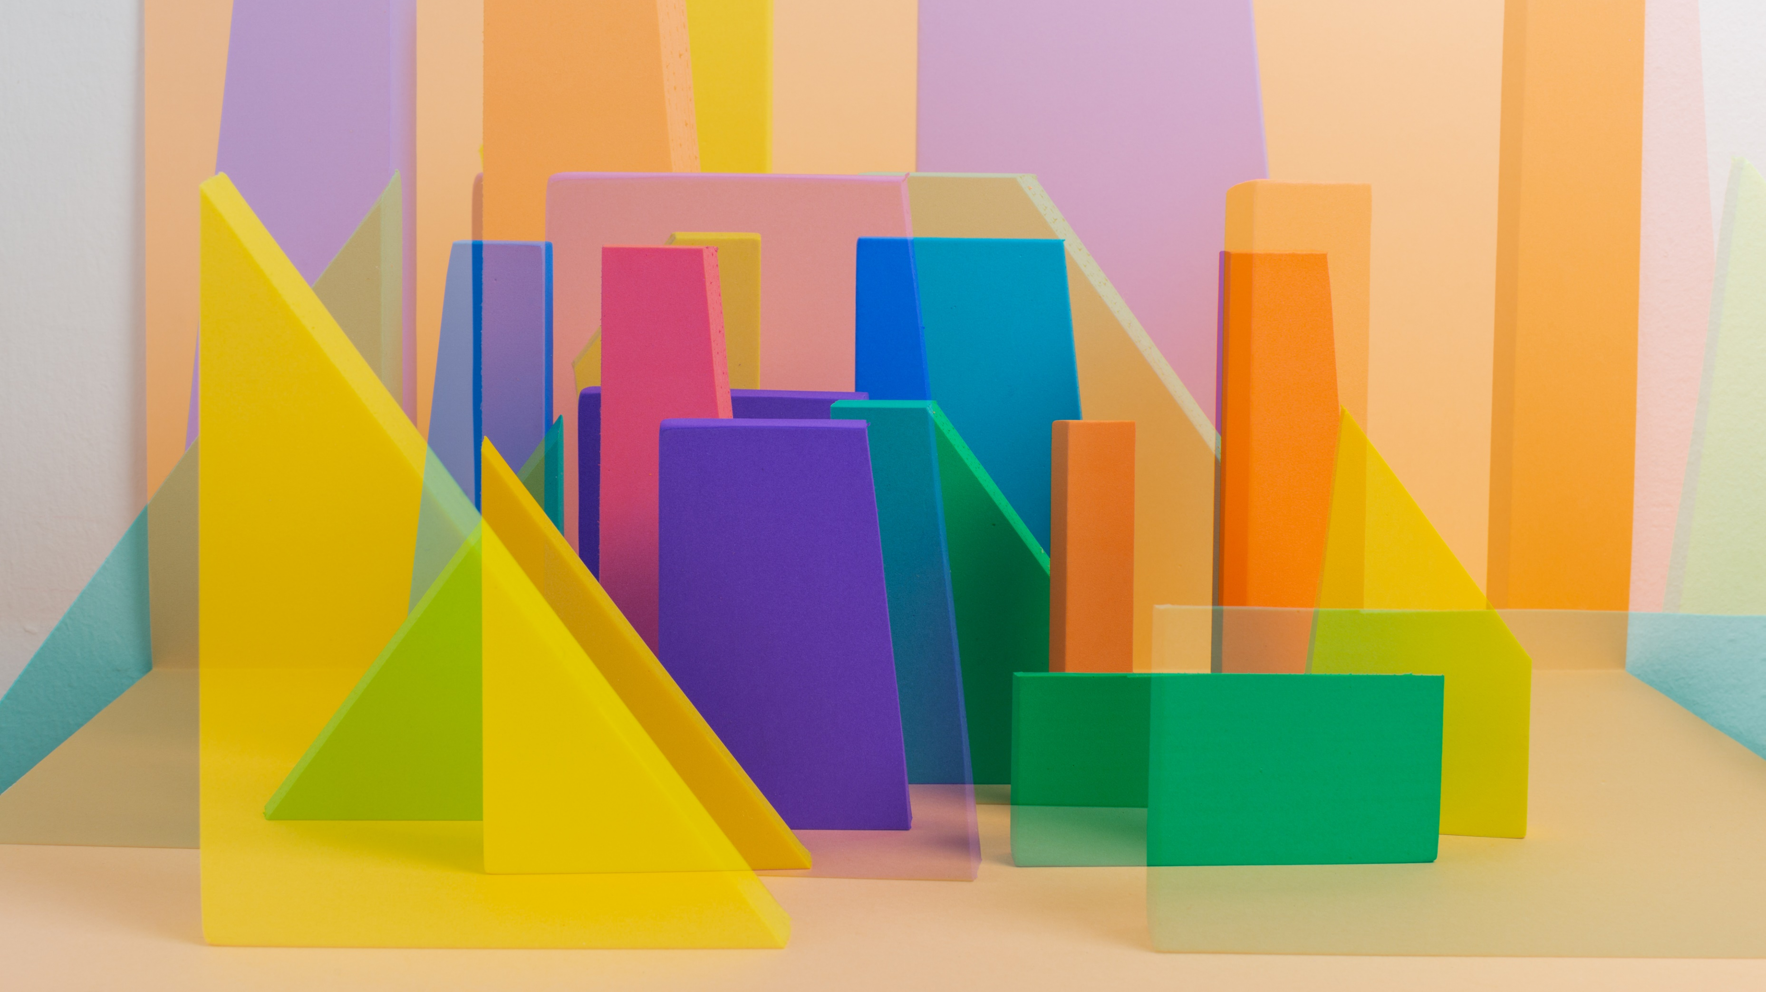

Learning Diffeomorphism based Data Augmentation
BY: Saloni Aggarwal
Advisor: Dr. Linwei Wang

Slide 2
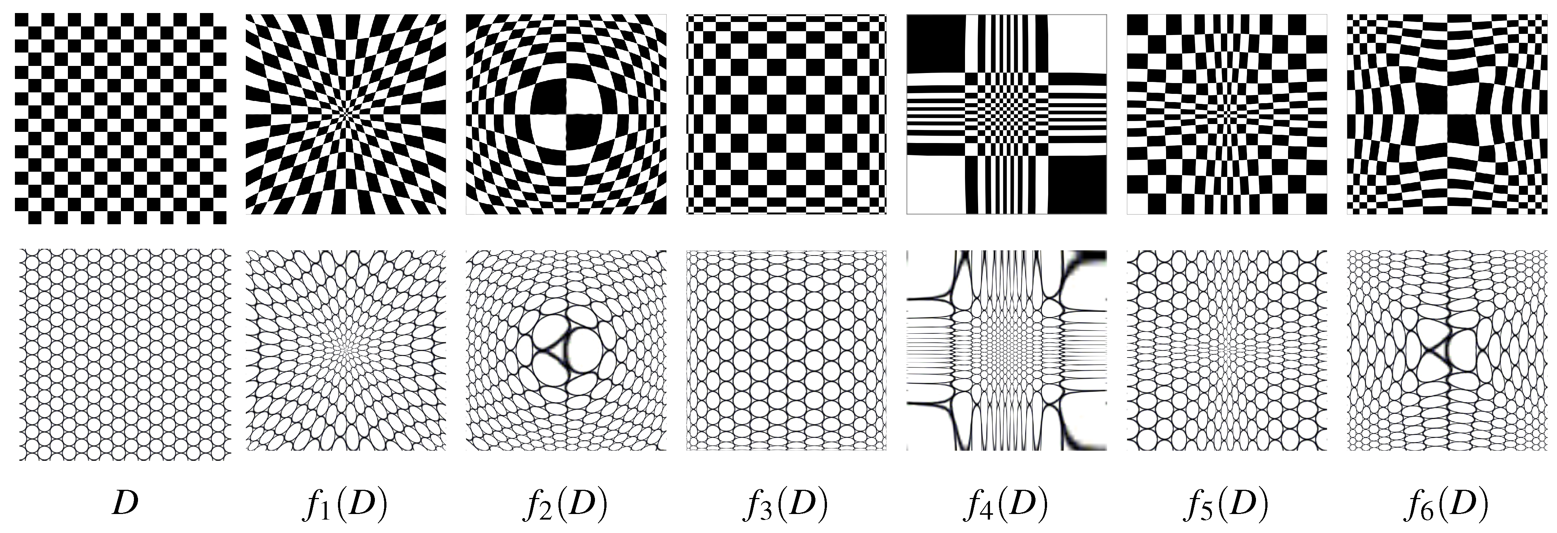
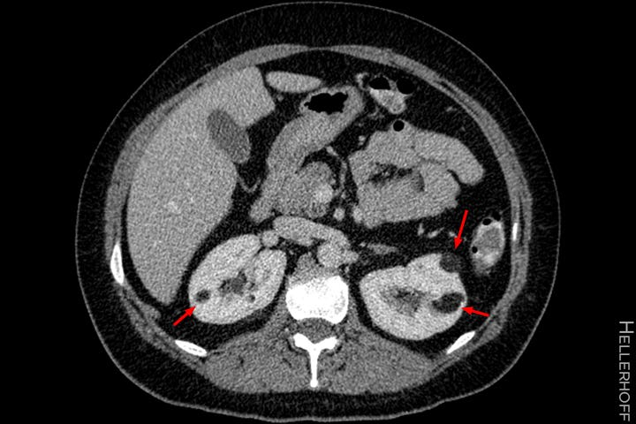
Overview
Propose an object-centric data augmentation method.
This will be achieved by transforming the object of interest (i.e., tumors) using variations in different instances of the object called diffeomorphism.
Notes:
I am proposing an object – centric data augmentation method for kidney tumor dataset. So, what I mean is that I want to increase the tumor dataset by performing a technique called diffeomorphism on the tumors from the CT scan images.

Slide 3
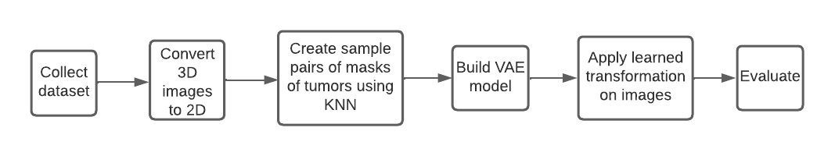
Architecture
Notes:
So, this is how my architecture look like. First, I had to collect dataset of kidney CT scan and convert 3D scans to 2D images. Then, I need to create sample pairs of these images using KNN algorithm and give these sample pairs as input to the VAE Model. The VAE model would learn some transformations and give that as output. The next step would be to apply these learned transformations on input images and then I had to validate my model by performing some experiments.

Slide 4
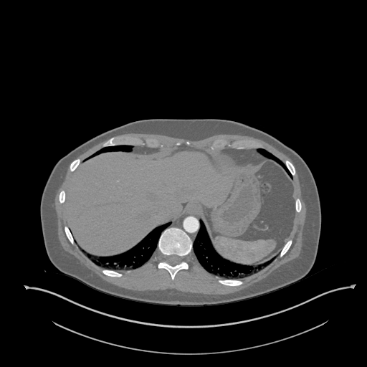
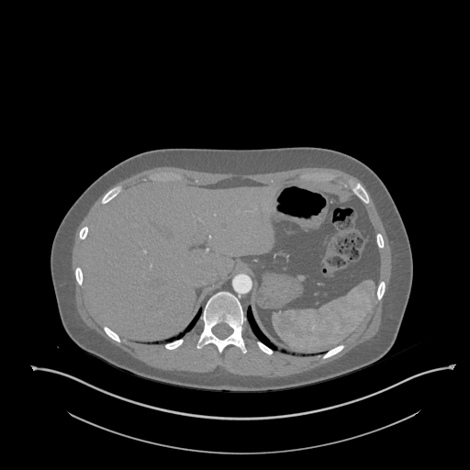
Milestone 1
Collected dataset - Kidney CT Scan images of 300 patients
Converted 3D scans to 2D images

Slide 5

Milestone 2

Slide 6
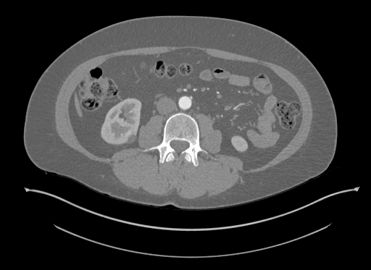
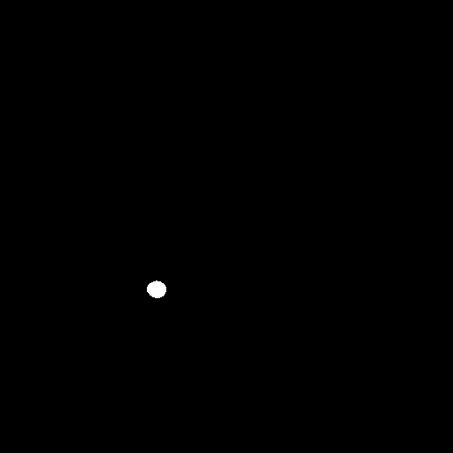
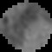

Creating masks and using KNN
Segmented out tumors from images.
KNN selects top 10 nearest images using Euclidean distance.
Returns a numpy array of source and target images
Notes:
From the dataset I also got hold of aggregated and segmented tumor instances. I used these tumor images and concept of bounding box to segment out the tumors from the 2D scan.
After segmenting out tumors, the next task was to make sample pairs of these tumor masks. By sample pairs I mean I want to combine source and target tumor mask into a single numpy array.
So for each image in dataset which is to be treated as source image, the KNN model is generating 10 sample pairs which are in form of numpy array.

Slide 7
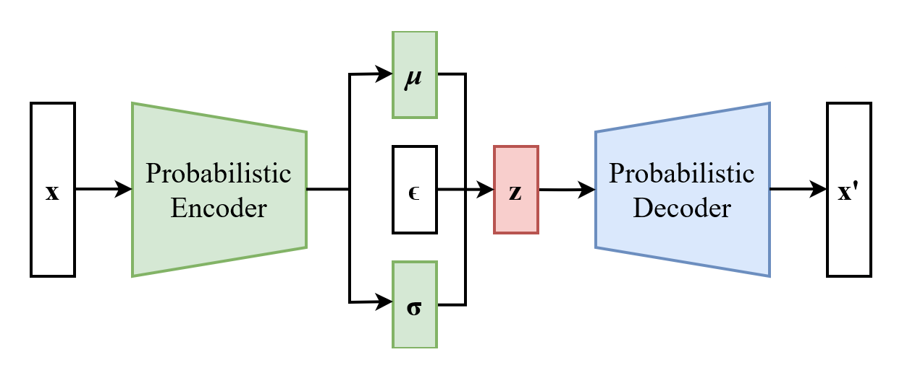
Variational Auto encoder
Encoder – produces “new features” representation from “old features”
Decoder – reverse of encoder
Mean and Variance - avoid overfitting
X – Sample pairs of source and target
Z- Learned transformation
X’ – Transformed image
Notes:
Autoencoders are a powerful tool of machine learning that is used for data compression and analysis. It learns hidden patters in the data that is being provided as input and use them to create new representation (or z) of original data. So, in variational autoencoder there are two parts: an encoder and a decoder.
Mean and variance are two regularizer terms used to avoid overfitting and also to make sure that the output learns good properties or transformations from old properties.
The main goal for my project is to get hold of these ‘z’ or new transformations because I want to generate multiple new tumor images from one source image.

Slide 8
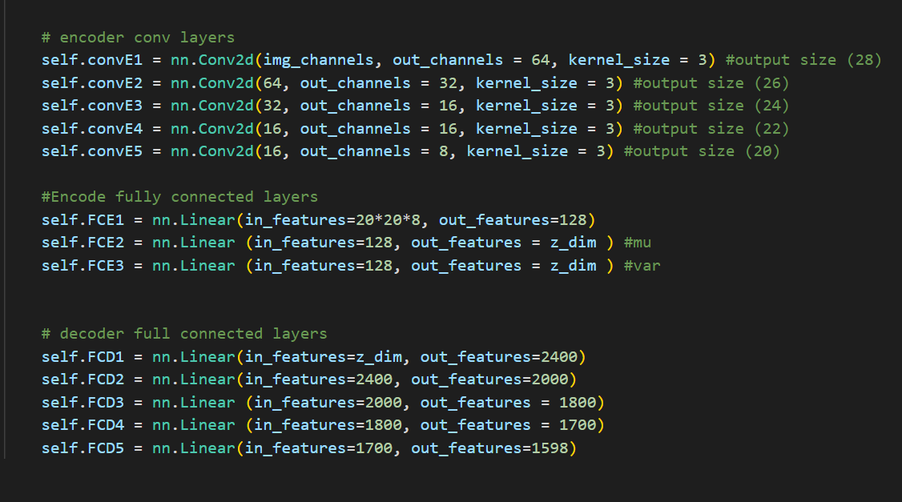
VAE Model
Notes:
The first 5 layers are the convolution layer which forms the encoder part of the model. The next three fully connected layers are used to regularize the mean and var. The next 5 fully connected layers form up the decoder part of the model.

Slide 9
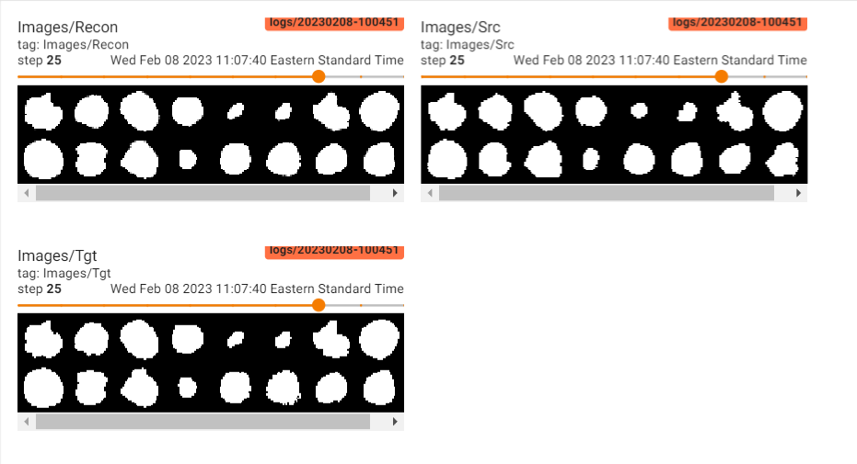
Results of reconstruction
Notes:
There is one parameter called velocity lambda. This parameter decides the change in velocity of each pixel in the image. The image above has a lambda value of 0.05.

Slide 10
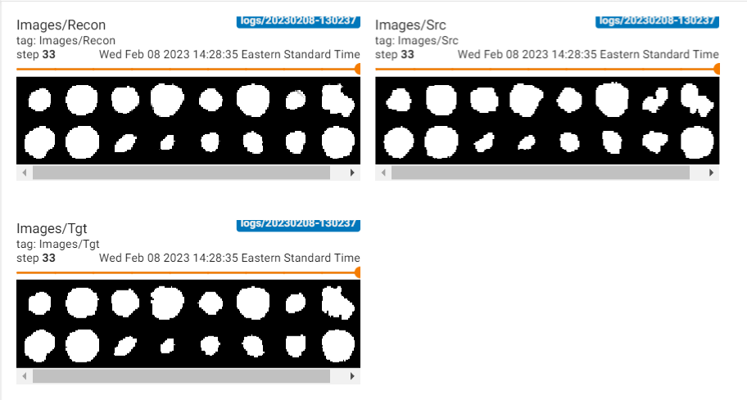
Results of reconstruction
Notes:
This reconstruction has lambda value of 0.01
For milestone 3, I am going to apply these reconstructions on original images. That is I will provide these reconstructions and original tumor images as input to the decoder of the vae model and analyze those results. I will conduct some experiments to analyze the features like textures, or how pixelated is the output from decoder.

Slide 11
Thank You !!
Questions?

